Slide 1



IGI Global Training
International Publisher of Progressive Information Science and Technology Research
University Name
Date

Slide 2
IGI Global Background
Founded in 1988
Headquartered in Hershey, Pennsylvania (USA)
International publisher of reference books, journals, and videos
Research focuses on the latest information science and technology advancements in academic subject areas
E-Resources innovator

Slide 3

IGI Global Research Growth
Promote Information Science and Technology Research
Partners with IRMA
158 Journals
Over 3,000 Books
E-Resources Leader
Conferences
Academic Papers
Expert Contributors
Peer-Reviewed
Comprehensive
Prestigious Indices
Cutting-Edge Research
Highly Cited
200 Subject Areas
Top-Rated Platform
Over 3,000 Customers in 160 Countries
Academic Video Lectures

Slide 4

What is the challenge?
Academic innovation requires technology research
partnership to bring the most cutting-edge materials
to students and faculty.
Over three-fourths (84%) of the universities
surveyed found it difficult to keep up-to-date
with applied technology books and journals.
“Universities have a responsibility to be more responsive to the needs of student and faculty innovators and researchers. It is time to get a reform underway, fast.”
–The Chronicle of Higher Education, July 2015

Slide 5
11 Diverse Subject Areas
Focusing on Information Science and Technology Research
Business and Management Information Science and Technology
Computer Science and Information Technology
Educational Science and Technology
Engineering Science and Technology
Environmental Science and Technology
Government Science and Technology
Library Information Science and Technology
Media and Communication Science and Technology
Medical, Healthcare, and Life Science and Technology
Security and Forensic Science and Technology
Social Sciences and Online Behavior

Slide 6
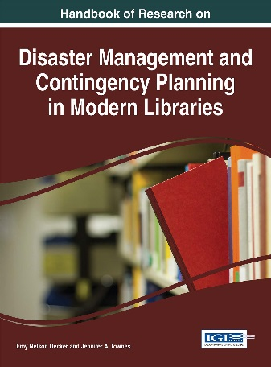
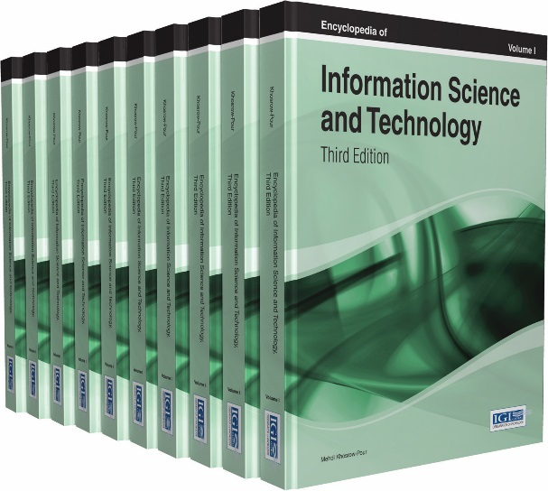
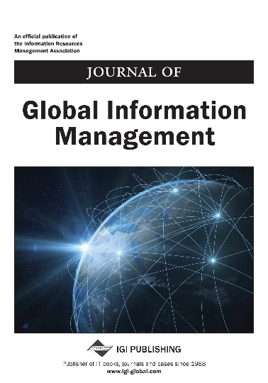




Interdisciplinary Content
IGI Global’s content features crucial trending topics of research across disciplines. From journals to books and videos, new content is available in databases weekly.
Journals
Videos
Reference Books
Handbooks of Research
Multi-Volume Books
Research Essentials
Case Books
Research Insights
Encylopedias

Slide 7


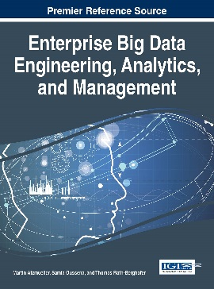
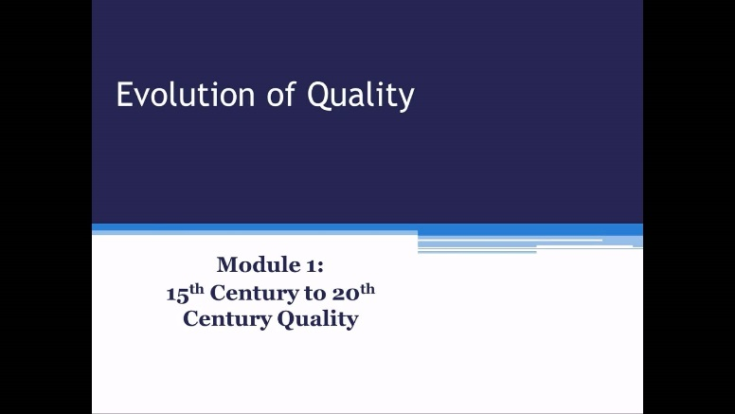
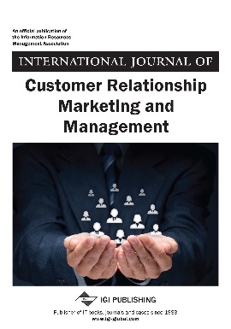

Business and Management Information Science and Technology
Accounting and Finance • Business Information Systems
Business and Organizational Research • Consumer Management • E-Commerce Economics and Economic Theory • Enterprise Information Systems
Enterprise Resource Planning • Entrepreneurship and E-Innovation
Global Business • Human Resources Development • Hospitality, Travel, and Tourism Marketing • Operations and Service Management • Risk Assessment
Small and Medium Enterprises • Supply Chain Management

Slide 8

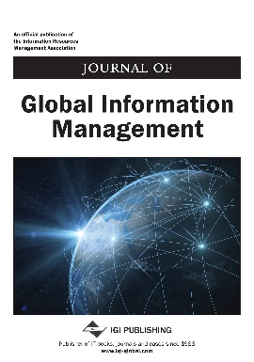
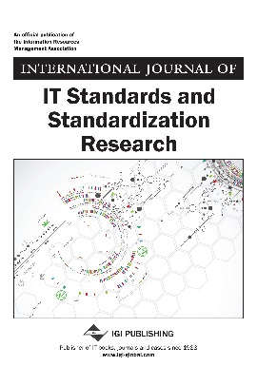
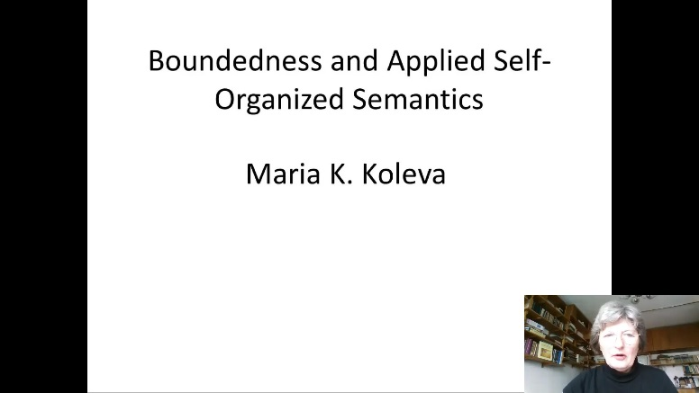
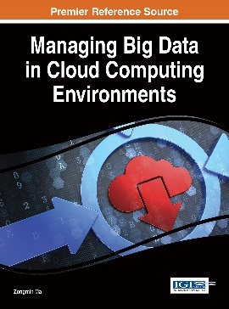
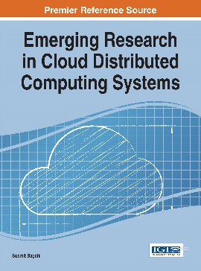
Computer Science and Information Technology
Artificial Intelligence • Cloud Computing • Cognitive Informatics
Computer Engineering • Decision Support Systems • Global Information Technology High Performance Computing • IT Research and Theory • Network Architecture Systems and Software Architecture

Slide 9

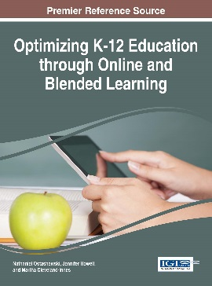
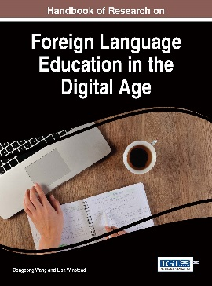
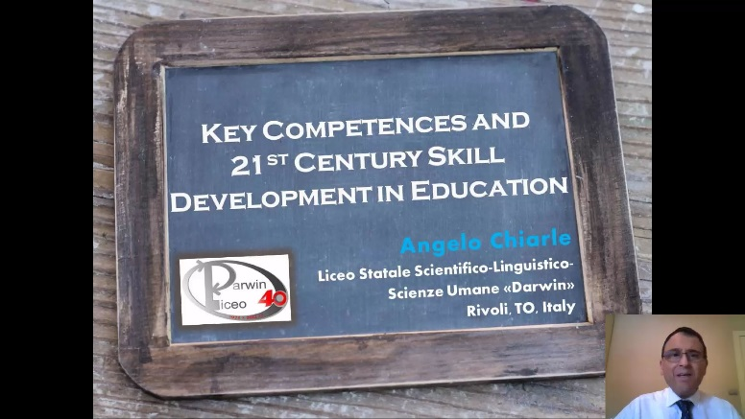
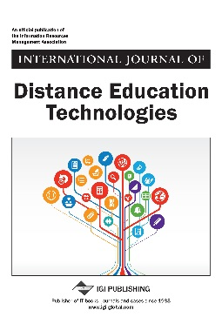
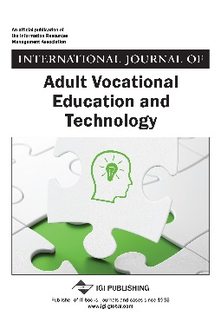
Educational Science and Technology
Applied e-Learning • Blended and Mobile Learning
Business and Technical Education • Cognitive Learning
Curriculum Development and Instructional Design • Distance Education
Educational Administration and Leadership • Engineering Education
Instructional Design • K-12 Education • Learning Assessment and Measurement Special Education • Technologies in Higher Education
Technologies in K-12 Education • Web-Based Teaching and Learning
Virtual Learning Environments

Slide 10



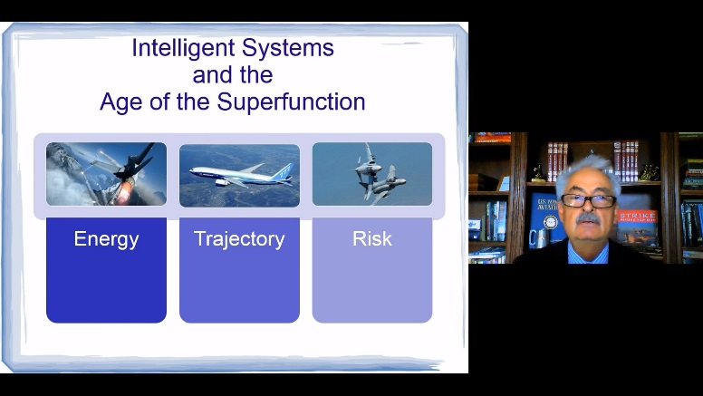
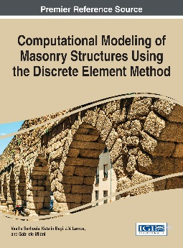

Engineering Science and Technology
Aerospace Engineering • Chemical Engineering • Civil Engineering
Computer Engineering • Electrical Engineering • Engineering Education
Industrial Engineering • Materials Science • Mechanical Engineering
Optical Engineering • Nuclear and Energy Engineering
Petroleum and Natural Gas Engineering

Slide 11



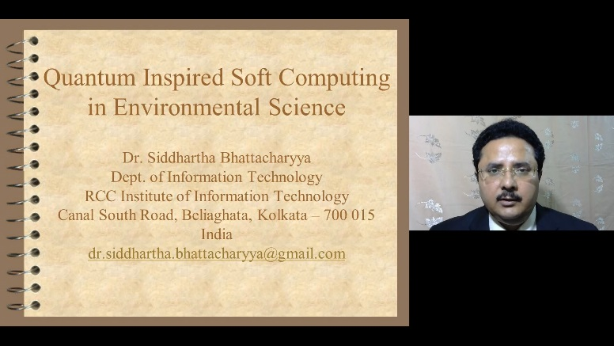
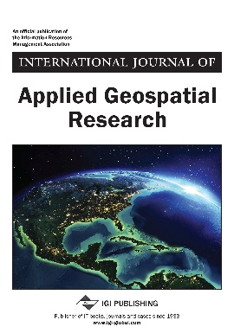
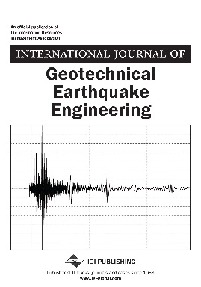
Environmental Science and Technology
Agricultural and Food Technologies • Earth Science • Environmental Engineering Environmental Technologies • Geographic Information Systems
Geoinformatics • Green Technologies • Surveying • Sustainability
Urban and Regional Development

Slide 12

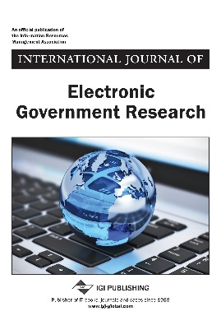
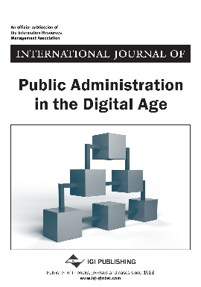
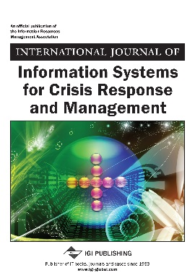


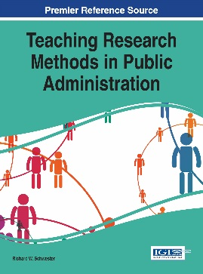
Government Science and Technology
Developing Countries • Digital Divide • Crisis Response and Management
Electronic Government • Emergency and Disaster Management • Law and Policy Public and Sector Management • Urban and Regional Development

Slide 13

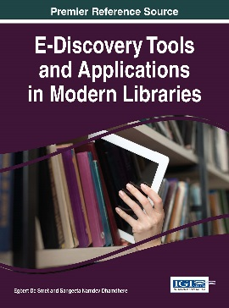
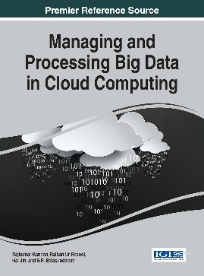
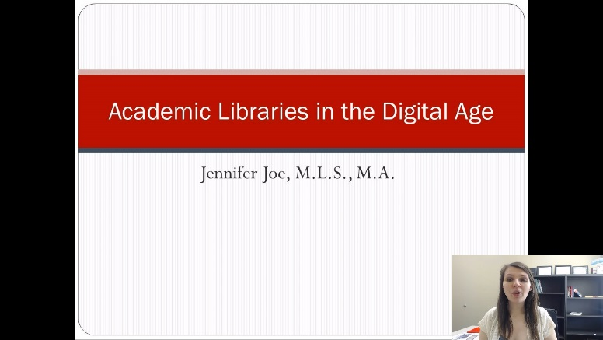
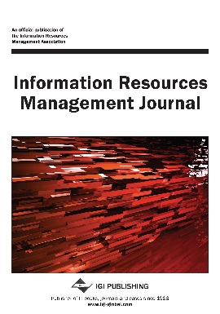
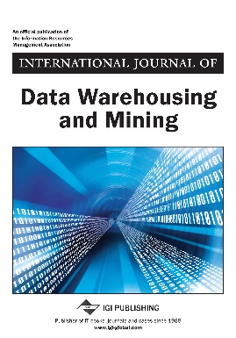
Library Information Science and Technology
Data Analysis and Statistics • Data Mining and Databases
Information Resources Management • Information Retrieval
Knowledge Management • Library Administration
Library Science • Research Methods

Slide 14

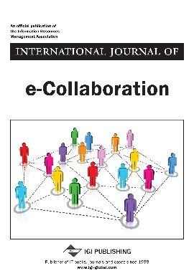
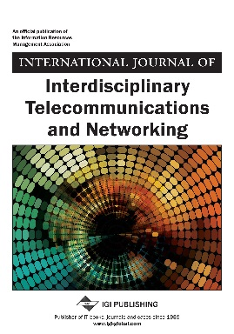
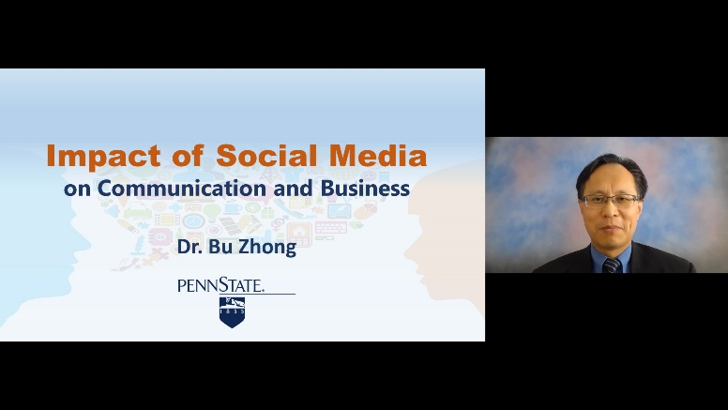
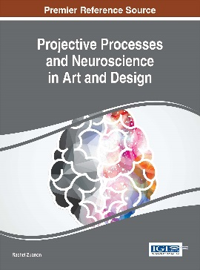
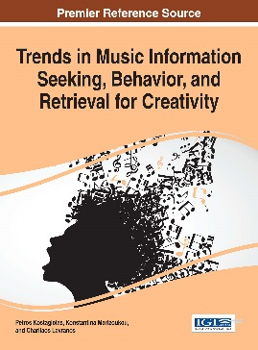
Media and Communication Science and Technology
Computer Graphics and Art • Gaming • Interactive Technologies
Internet Technologies • Mobile Computing • Multimedia Technology
Networking • Music Technologies • Portal Technologies • Semantic Web
Sensor Technologies Social Networking • Telecommunications
Web Engineering • Web Services • Wireless Systems

Slide 15

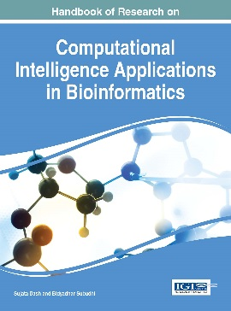
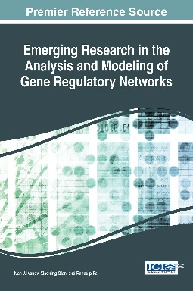
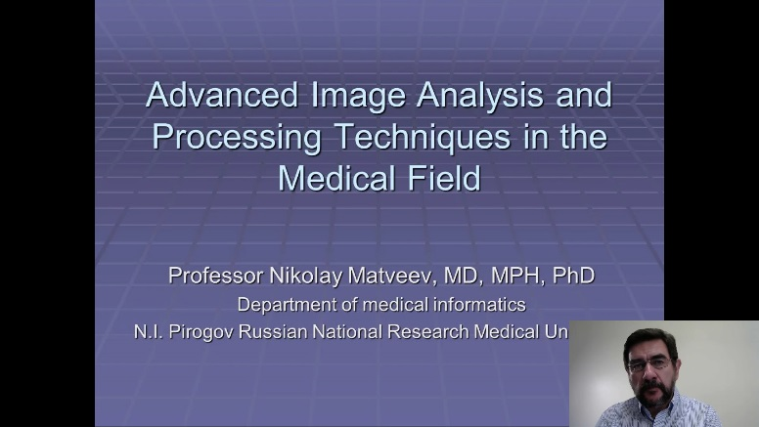
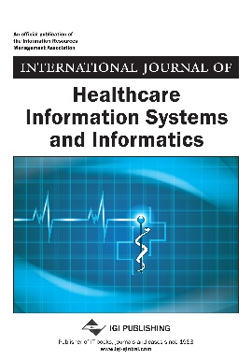
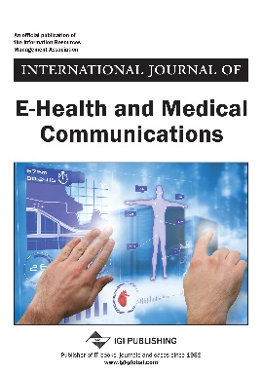
Medical, Healthcare, and Life Science and Technology
Assistive Technologies • Bioinformatics • Biologically Inspired Computing Biomedical Technologies • Biometrics • Chemo Informatics • Clinical Technologies E-health • Healthcare Information Technologies • Telemedicine

Slide 16


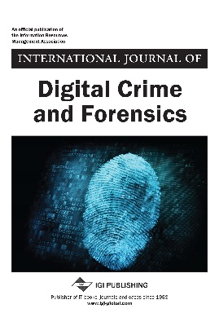
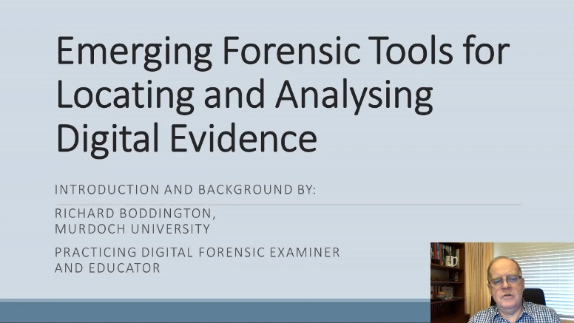
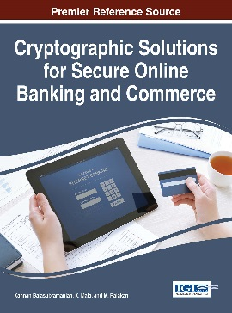

Security and Forensic Science and Technology
Biometrics • Cyber Warfare and Terrorism • Cryptography
Cyber and Network Security • Digital Crime and Forensics • Hacking
Information Ethics • Information • Security and Privacy • Information Trust Surveillance Systems

Slide 17

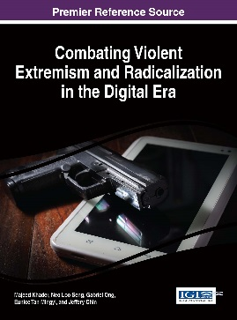

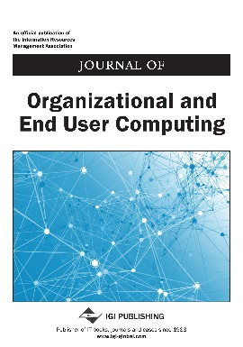


Social Sciences and
Online Behavior
Archaeology and Anthropology • Ethics and Social Responsibility
Human Aspects of Information Technology • Human Computer Interaction
Political Science • Religious Studies • Socio-Economic Development • Sociology

Slide 18





Peer-Reviewed and Indexed
All journals and books highly recognized and acquired through several indices
ACM Digital Library
Bacon’s Media Directory
Cabell’s Directories
INSPEC
Index of IS Journals
DBLP
PsycINFO
Compendex
Scopus
Thomson Reuters

Slide 19
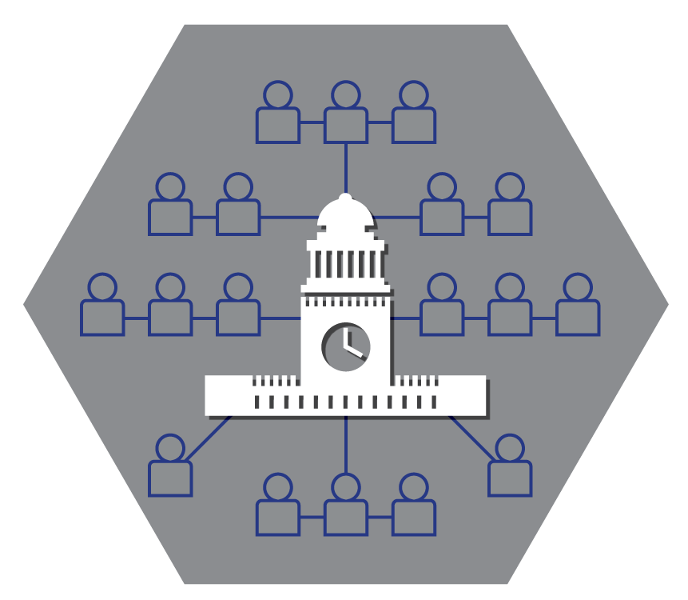
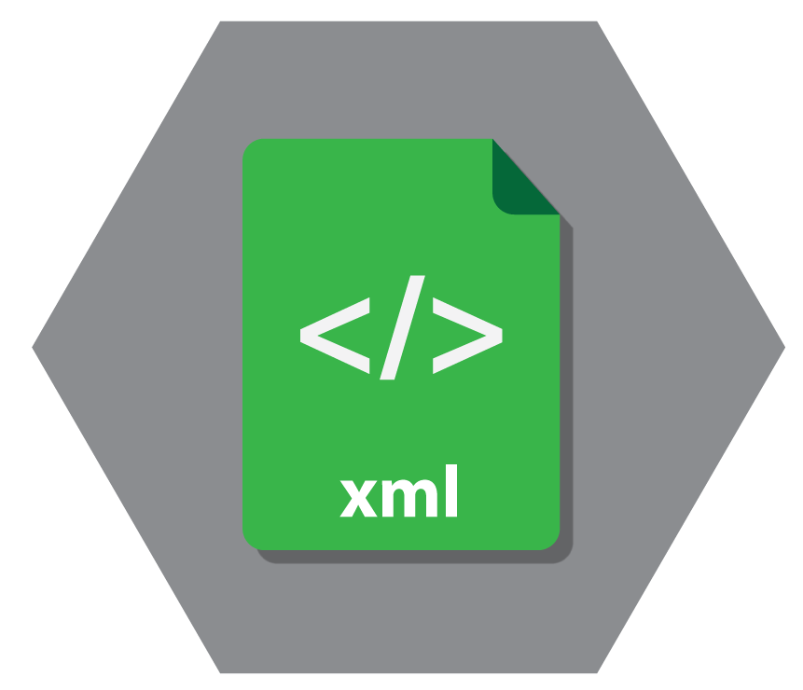





Top-Rated Platform for Researchers
Full-text in XML and PDF
No DRM: Copy, Paste, and
Print Directly from the Platform
Unlimited Simultaneous Users
Advanced Search Engine
Popular Citation Tools
No Embargo of Content

Slide 20
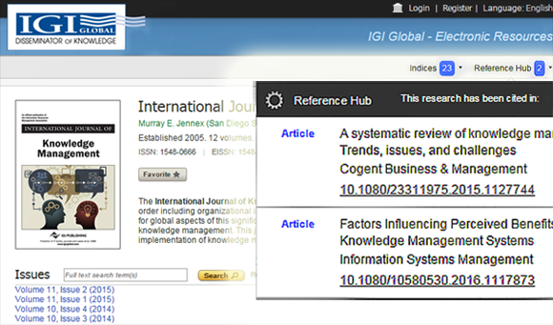
New Features for Researchers
Reference Hub
A visual representation of the number of
citations when viewing research
Automatic citation generator that continuously
updates where the research is being used
Citation information from books, journals,
proceedings and conferences
DOI information which connects
researchers with the research cited in the article
Indices
Automatic generator of indices which have recognized the publication
Quickly link to the indices home page

Slide 21



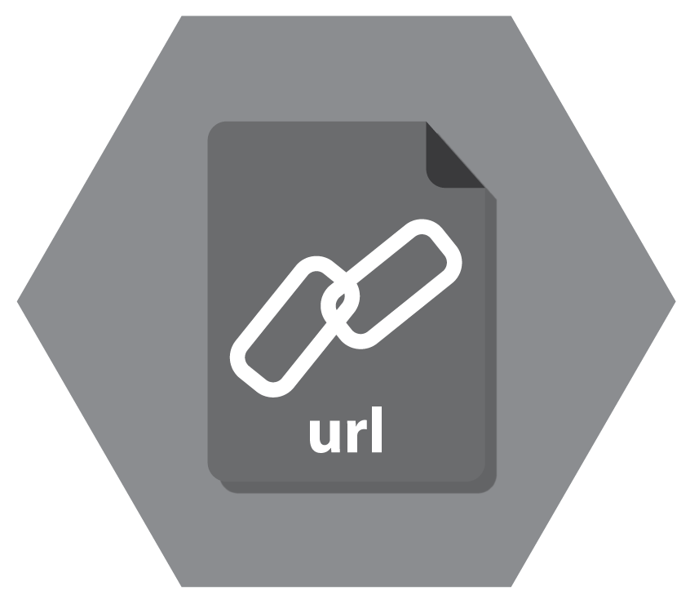



Librarian-Friendly Features
Personalized Platform
Persistent URLs
COUNTER4 Compliant Usage Statistics
Free MARC Records
Integrates With Discovery Services
Archival Access
No Maintenance or Service Fees

Slide 22

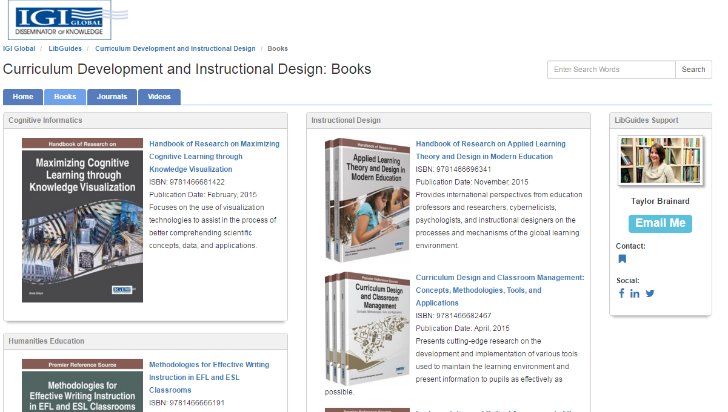

New Features for Librarians
LibGuides
Librarians are able to easily copy and past entire
subject specific guides directly into their LibGuides
Save time!
IGI Global Search Box allows search capabilities of
university’s holdings
Also offering customized LibGuides
Profiles of Use
Handout to tell the story of how universities
are utilizing IGI Global e-books, e-journals
and videos to make an impact in their
academic communities.
Showcases seven international universities

Slide 23



Searching Options
Basic Search
Enter the desired terms into the basic search box and click the search icon
Refine your results with the Refine Results menu navigation to the right
Advanced Search
Used to quickly and easily narrow your search fields in your initial search
Expert Search
Unique to IGI Global and offers a detailed search option for users
Search with certain terms excluded, included, or weighted within your results

Slide 24




InfoSci-Databases
Databases for Progressive Information Science and Technology Research

Slide 25

InfoSci®-Books
Comprehensive Collection
Over 69,000+ full-text chapters from over 3,000+ reference books
Unlimited Simultaneous Access
No limits as to how many concurrent users are logged in and using the
content simultaneously
Full-text PDF viewing that allows copy, paste, and printing capabilities

Slide 26

InfoSci-Books Reviews and Testimonials
"A major strength of the database is a common repository of these publications that hasn't existed before this time… The timeliness of information is improved because publications can be made accessible before the paper copy is received in the mail. In the past, one had to wait for the distribution of journals to gain access to them (in a library setting, or university distribution center this may take longer than one would think). The online system means access to information anywhere and at any time. This is critical for many researchers who are working at home, in the office, or perhaps even abroad."
- Shirley A. Becker, PhD, Northern Arizona University
"This database is excellent for locating a wide range of documents which will be of use to me and my students."
- Susan Myburgh, PhD, University of South Australia, Australia
"It's really provides an excellent entry into the research literature of the field. It presents a manageable number of highly relevant sources on topics of interest to a wide range of researchers. The sources are scholarly, but also accessible to 'practitioners'."
- Lisa Stimatz, MLS, University of North Carolina at Chapel Hill, USA

Slide 27

InfoSci®-Journals
Comprehensive Collection
Over 17,000+ full-text articles from more than 158+ scholarly journals
Unlimited Simultaneous Access
No limits as to how many concurrent users are logged in and using the
content simultaneously
Full-text PDF viewing that allows copy, paste, and printing capabilities

Slide 28

InfoSci-Journals Reviews and Testimonials
"It is not only about the wide coverage of the database, it is about the quality of the contributions. In certain areas, Information Technology, for instance, it is normal to discover a handful of relevant papers published in the last months covering up-to-date technologies recently launched."
- Dr. Ricardo Colomo-Palacios, Universidad Carlos III de Madrid, Spain
"InfoSci®-Journals is a treasury for researchers, educators, R&D engineers, and managers. Going beyond the boundaries of professional fields of IT/IS, it extends its range to be more interdisciplinary. InfoSci®-Journals database provides high-level, valuable articles with insights and implications for experts in educational, managerial, and governmental fields. Teachers and professors can also find interesting teaching cases in this prestigious database.
- Chia-Wen Tsai, Assistant Professor, Department of Information Management, Ming Chuan University, Taiwan
"I have faculty in my computer science department chomping at the bit for this kind of content!"
- Lia Hemphill, Nova Southeastern University, USA

Slide 29

InfoSci®-Videos
New for 2016!
51 streaming video lectures in the 2016 collection
Internationally-Recognized Scholars and Industry Leaders
Complementary to IGI Global publications
Unlimited Simultaneous Access
No limits as to how many concurrent users are logged in and using the
content simultaneously
Closed Captioning

Slide 30
InfoSci-Videos Reviews and Testimonials
"Amazing breadth, with online teaching and learning covered extensively. The cast of lecturers is quite international, although presentations are entirely in English. Videos are viewed directly in the browser window and may be expanded to a full-screen view while retaining quality."
- Bonnie J.M. Swoger, Library Journal

Slide 31
Questions and Answers

Slide 32
Thank You

